Slide 1
BANKSY VS ROBBO
SHABI SHAMS

Slide 2
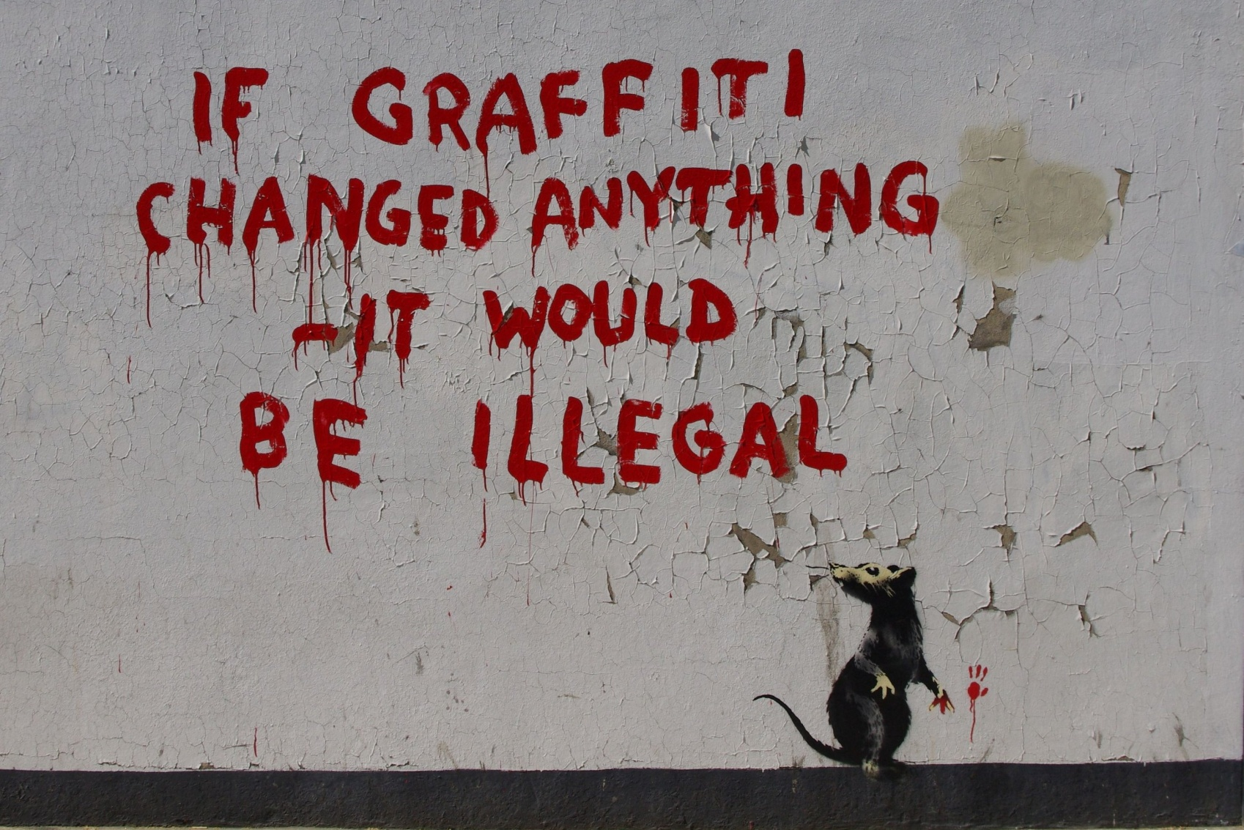
BANKSY ART

Slide 3
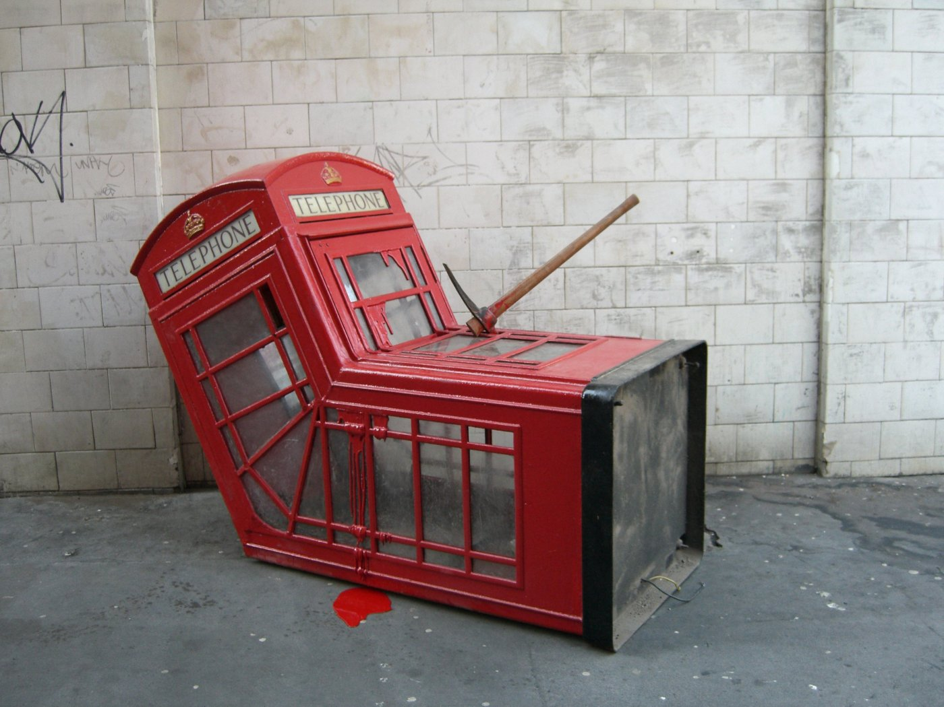

Slide 4
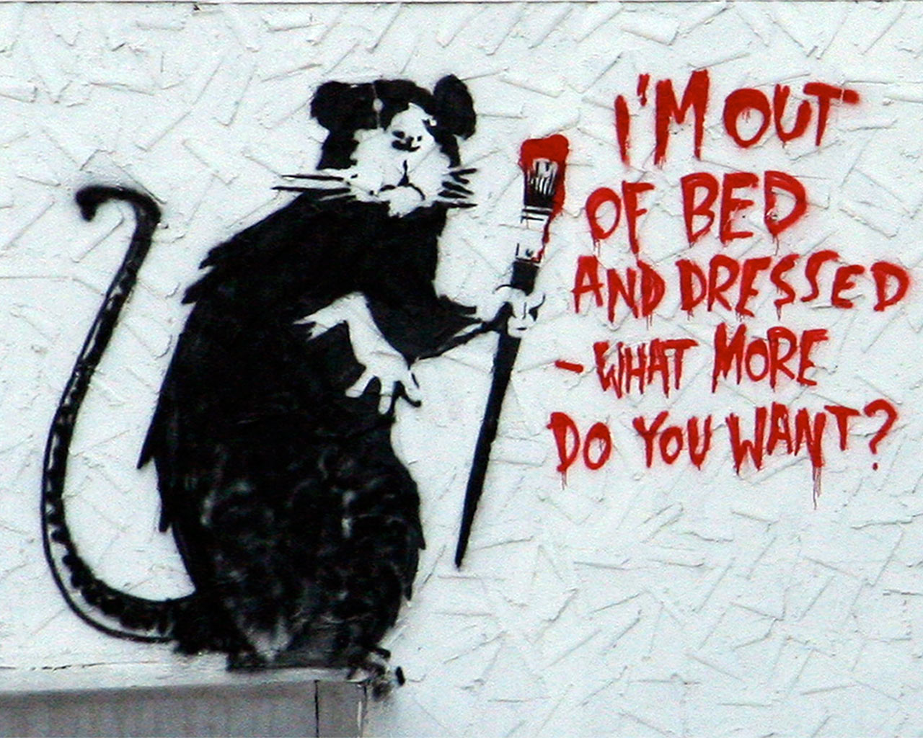
One of the most famous banksy`s art

Slide 5
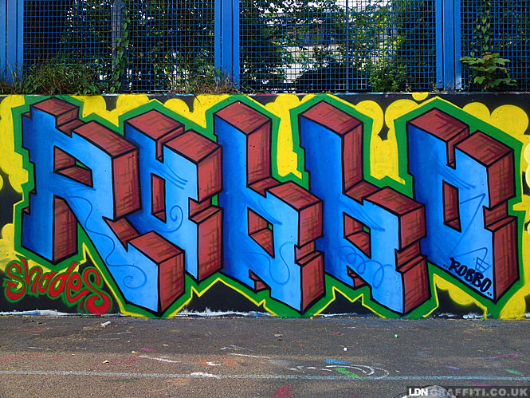
ROBBO

Slide 6
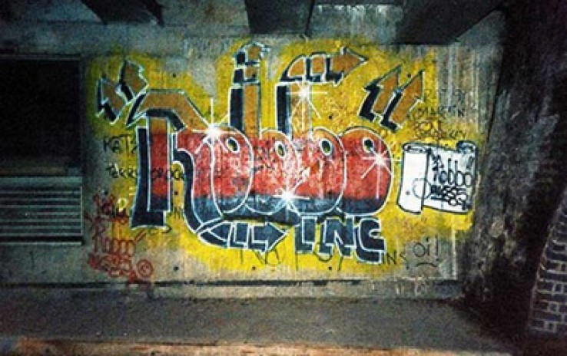
The last peace of robbo`s art before his retirement

Slide 7
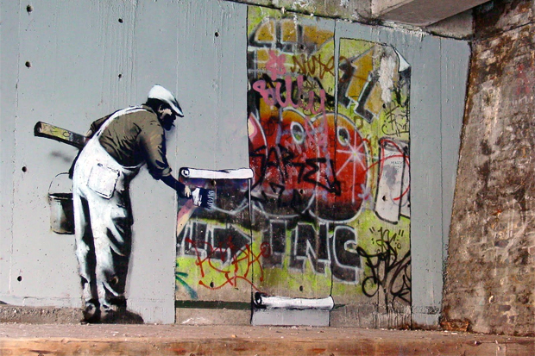
Banksy never followed any graffiti laws and he had tried to began a war with robbo

Slide 8
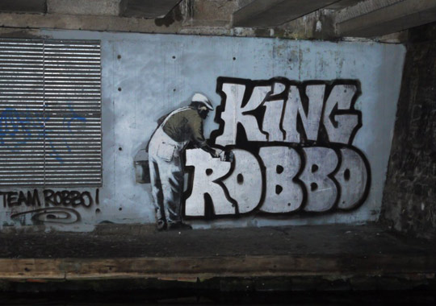
But robbo fight back

Slide 9
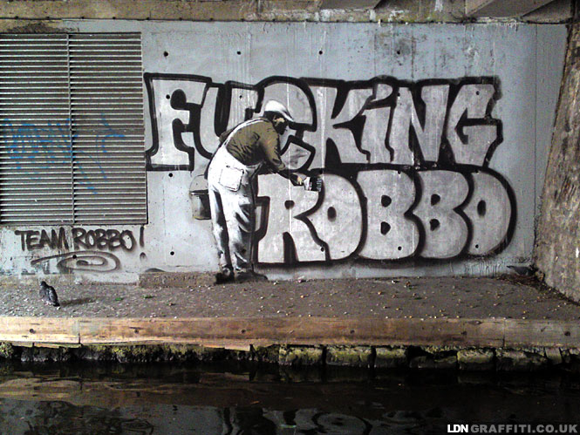
And so do banksy

Slide 10
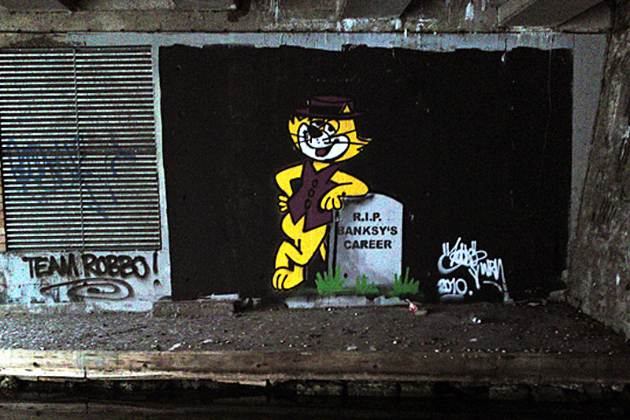

Slide 11
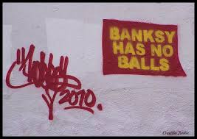

Slide 12
